Slide 1
Creating our plot
This week we will begin creating our story plot and plan out our stories based on our explorer in the rainforest. Using the slides and resources provided. Can you create a plot for your story in the Amazon Rainforest.

Slide 2
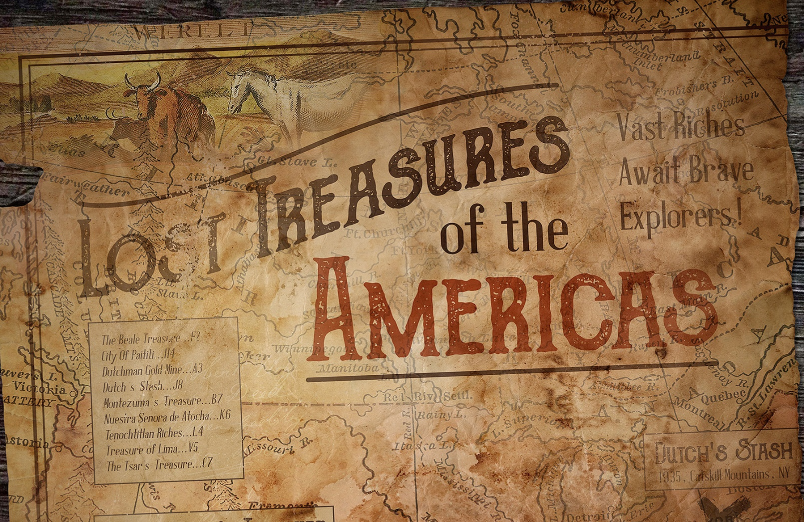
Your story will start with your character this map detailing lost treasures in North and South America. Your character will be drawn to a location deep in the Amazon Rainforest and begins planning his expedition to search for the treasure.
The rest is up to you….

Slide 3
BBC Live lesson
The link below allows you to watch a live lesson taught by famous authors. The lesson is based on creating an interesting plot and story ending.
Follow the video and complete the tasks.
https://www.bbc.co.uk/programmes/articles/2yRxNT9ws7MkJsFvbxPfhry/500-words-2018-live-lesson

Slide 4
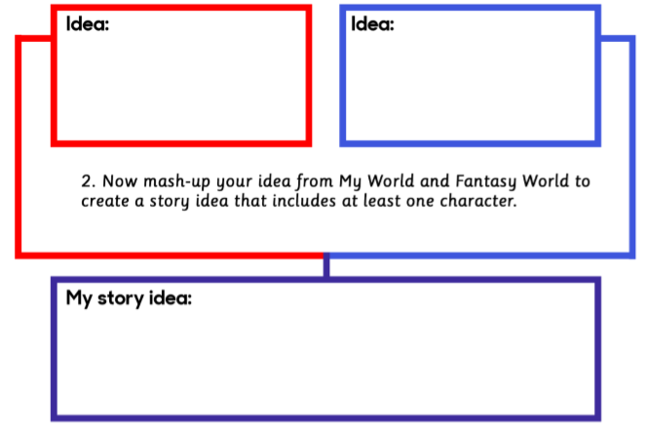
Activity 1
Using the sheet provided, can you provide ideas based in the real world and combine them with our rainforest setting to create a story idea.

Slide 5
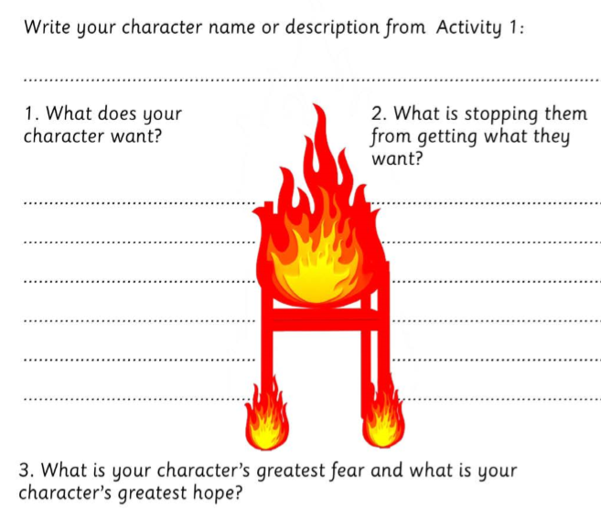
Activity 2
Using your character descriptions that you have already created. Answer the questions provided in the worksheet.

Slide 6
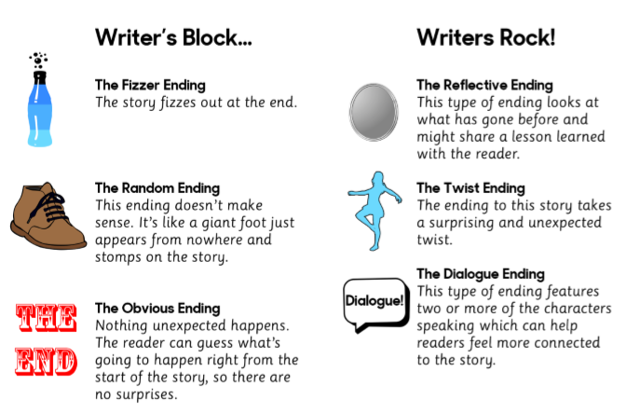
Activity 3
This activity helps you to create interesting story endings. Use the activity sheet to help identify different story endings and then come up with how your story will end.

