Slide 1
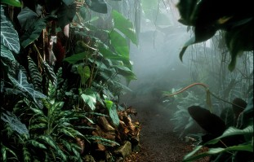
We can describe a setting.
What does describe mean?
What does setting mean?
http://www.bbc.co.uk/learningzone/clips/the-amazon-rainforest/8975.html

Slide 2


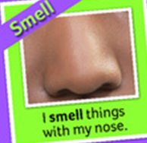

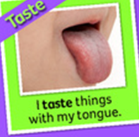
What will help us to describe the setting?

Slide 3





The five senses adjectives
shiny
glittering
rushing
swooping
croaking
soaring
slithering
bright
squawking
colourful
gushing
murky
dark
chattering
colossal
scaly
pungent
slimy
humid
fragrant
smooth
sweet
sharp
fresh
rough
juicy

Slide 4
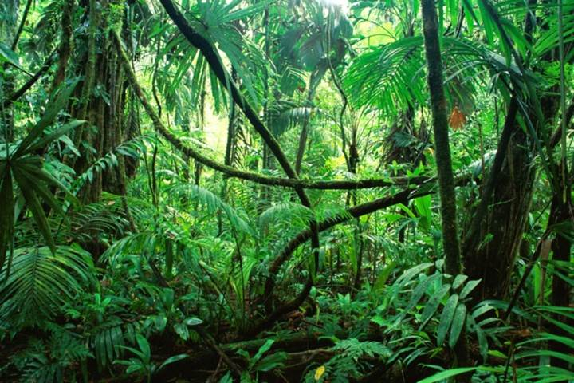
Deep in the dark Amazon rainforest, living things are all around.
High above and down below, see the sights and hear the sounds.
Bravely enter this marvellous place;
hurry, there’s no time to waste!

Slide 5
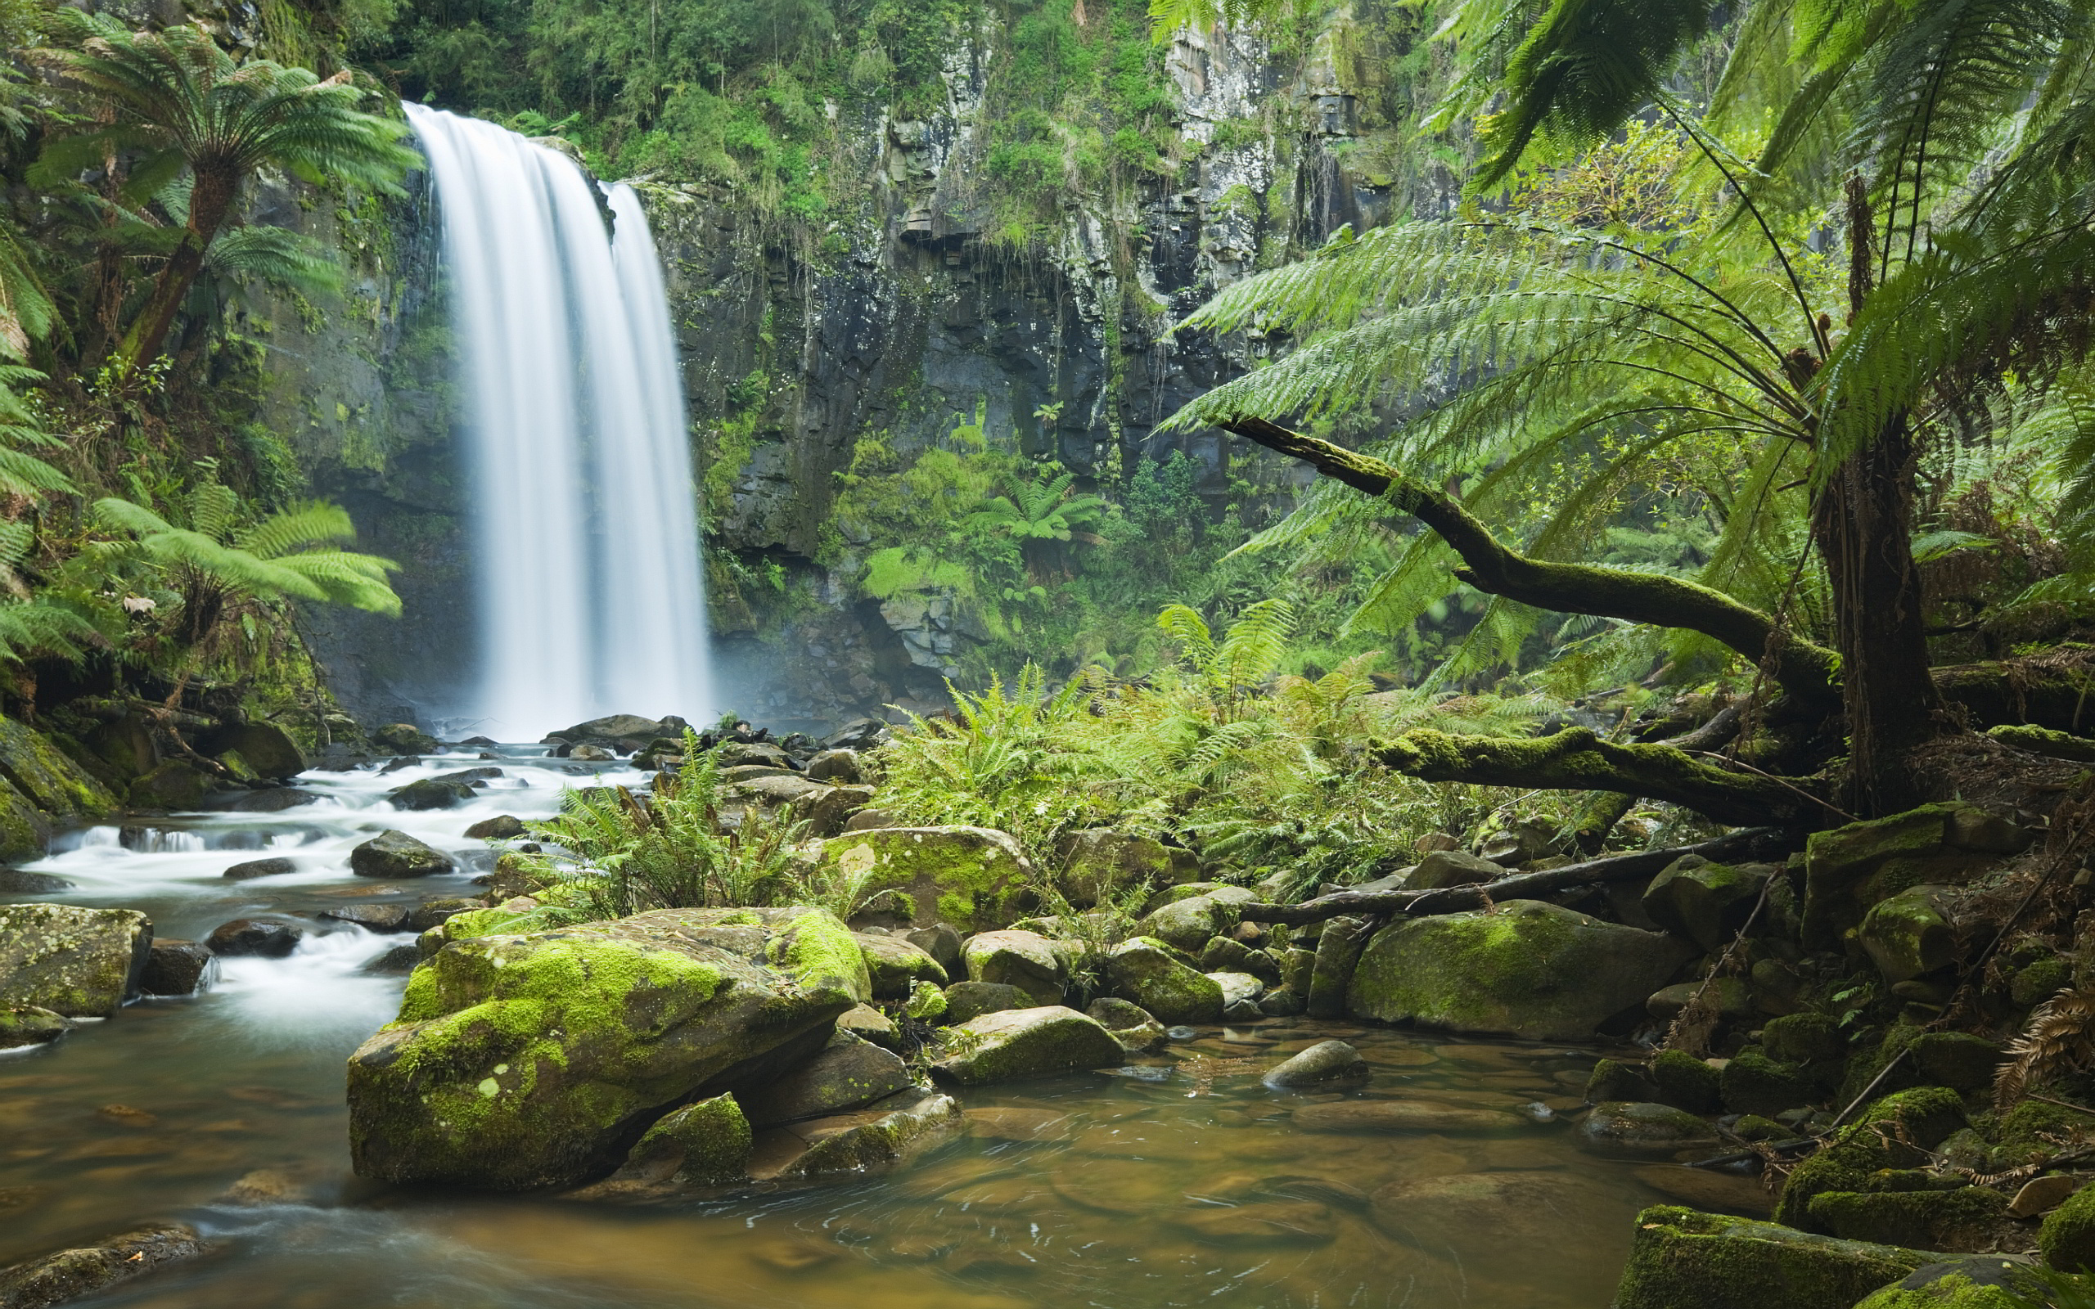
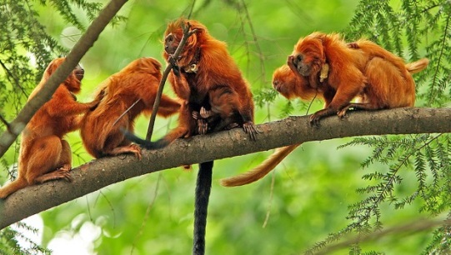
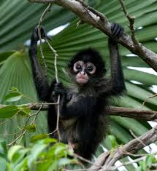
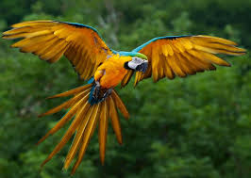

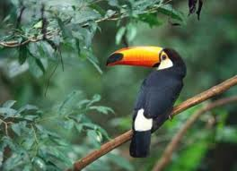
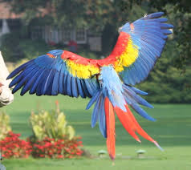
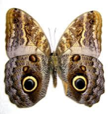

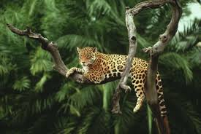

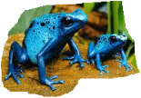
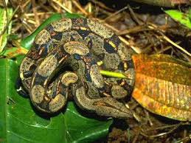


Slide 6

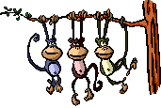

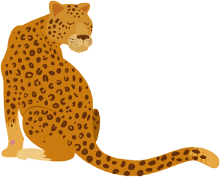
Deep in the dark Amazon rainforest, the glittering sun warms my skin. It is humid so I sip some fresh water from the rushing river. The gentle wind blows in my hair.
I look all around and see creatures great and small. I see cheeky, chattering monkeys swinging from tree to tree. I quietly tip-toe past the lazy leopard so that he won’t see me!
Next, I smell the sweet scent of juicy berries growing on the tall, colossal trees. A colourful toucan suddenly swoops down to pick a berry with it’s sharp beak. It soars high into the sky, far above the playful monkeys, before resting on a branch.
After that, a slimy frog hops out of the gushing river and lands on me. My shriek stirs the dozing leopard so I run away as quick as a flash!

